Slide 1

May 2025 Katie Dunn and Katie Bremner (HR Consultants AAB)

Slide 2

Agenda
AAB Resources for You
Group Discussion on Service and Resources
Recent Changes to Legislation
Pension and Payroll pointers
Q & A

Slide 3


The HUB
HR Resources
HR Templates
Links to latest Blogs on Legislations Changes and Practical Tips
Mental Health and Wellbeing Hub
Previous Webinar recordings
LinkedIn to AAB

Slide 4
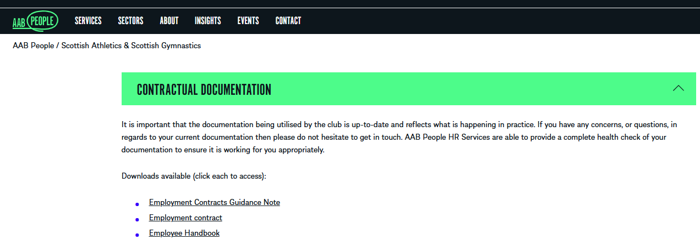
Contractual Template Documents
The following contractual documents are available on the hub for you

Slide 5
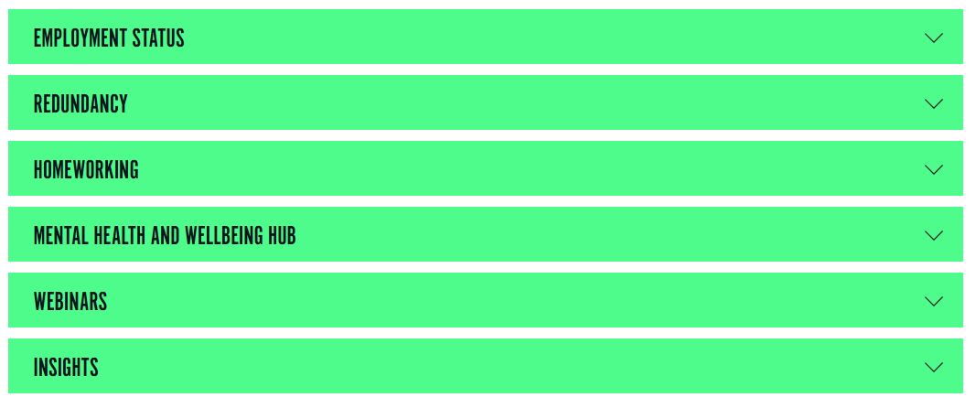
What else can you find on the Hubs?
Notes:
Employment status- defines the different types of status, which is helpful when you are working with employees, contractors etc..
Redundancy- Some guidance on Alternative, preparation and process
Home working- Guidance for managers on leading a team in this environment, Policies, DSE assessments etc..
Mental Health and wellbeing- Support and guidance on taking care of mental health
Webinars- Previously held webinars
Insights- Link for blogs on current topics

Slide 6

Let’s Breakout into Groups
Help us to Help you!
Notes:
What else do you want to see here
EXAMPLES
FWR
Sick pay guidance
Salary increase letter
Long term sick
Return to work

Slide 7

Your ideas and actions for us- Discussion

Slide 8

Update clubs on recent changes to key legislation
Neonatal Care Leave and Pay
April 2025
Starting April 6, 2025, the UK introduces Neonatal Care Leave (NCL) and Neonatal Care Pay (NCP) to support parents whose newborns require specialized hospital care. Eligible parents can take up to 12 weeks of leave, in addition to existing maternity and paternity leave entitlements. NCP is available to qualifying employees at a rate similar to statutory paternity pay. These measures aim to assist parents during critical periods when their newborns are hospitalized.
Sexual Harassment
Worker Protection Act 2023
In October 2024, new UK legislation came into effect requiring employers to proactively prevent sexual harassment in the workplace.
Employers must take steps to address potential harassment before it occurs, including by third parties like clients or suppliers.
Failure to comply can lead to higher compensation awards in harassment cases.
Employers are urged to implement anti-harassment policies, training, and risk assessments to meet these legal obligations.

Slide 9

Changes to minimum and living wage
Starting April 1, 2025, the UK will implement significant increases in the National Minimum Wage and National Living Wage, as recommended by the Low Pay Commission
National Living Wage (21 and over): Increases by £0.77 (6.7%) to £12.21 per hour.​
18-20 Year Old Rate: Increases by £1.40 (16.3%) to £10.00 per hour.
16-17 Year Old Rate: Increases by £1.15 (18.0%) to £7.55 per hour.​
Apprentice Rate: Increases by £1.15 (18.0%) to £7.55 per hour.​
Accommodation Offset: Increases by £0.67 (6.7%) to £10.66 per day.​
These adjustments aim to support workers amid ongoing cost-of-living challenges. Employers should review and adjust payroll systems accordingly to ensure compliance

Slide 10
Pipeline legislation changes…
Changes to 0 Hour Contracts
The UK government has introduced significant reforms to address the use of zero-hour contracts through the Employment Rights Bill.
While a complete ban isn't proposed, the bill aims to provide greater job security and predictability for workers currently on such contracts. Key measures include:
Guaranteed Hours Offer: Workers identified as 'qualifying workers'—those on zero-hour or 'low hours' contracts who have worked beyond their contracted hours over a specified reference period—will have the right to a 'guaranteed hours offer.' This offer involves a new or modified contract that reflects the average hours worked during the reference period, ensuring a minimum level of work and income stability.
Inclusion of Agency Workers: To prevent employers from circumventing the regulations by utilizing agency workers, the ban on zero-hour contracts will extend to include agency workers. Employers will be mandated to offer agency workers contracts that guarantee minimum weekly hours. ​
Regulation of Umbrella Companies: Umbrella companies, which often leave workers uncertain about their employment rights and responsibilities, will come under stricter regulation to ensure clarity and protection for the workers they employ.

Slide 11

Pension and Payroll Basics

Slide 12
Pensions and Payroll
Holidays, sick leave, and other types of leave.
Working time limits.
Employee's right to work documentation.
Training and development records.
Appraisals and employment history.
Appraisals and employment history.
Personal details (name, address, etc.).
Terms and conditions of employment.
Record Keeping Basics
Payroll record-keeping is a crucial duty of care for employers, ensuring accurate and compliant payroll processes.
This involves maintaining detailed records of employee pay, deductions, and other relevant data, as well as complying with regulations like GDPR for data protection.

Slide 13
Pensions and Payroll
Key Responsibilities and Record-Keeping:
Accurate Record Keeping: Employers must keep detailed records of all employee pay, deductions (like tax and National Insurance contributions), and other relevant information.
Legal Compliance: Record-keeping must comply with various laws and regulations, including those related to minimum wage, working hours, and statutory leave.
Data Protection (GDPR): Employers have a duty to protect employee data and ensure it is stored securely and accessed only by authorized personnel, as per GDPR.
HMRC Reporting: Records must be accurate and support any reporting requirements to HMRC, such as Real Time Information (RTI) for PAYE and payroll.
Retention Period: Most payroll records must be kept for at least three years, and some records may need to be kept for a longer period, such as six years for payroll data or seven years for contractor payments.

Slide 14
Pensions and Payroll
Secure Storage: Records should be stored securely, whether in physical or electronic format, and disposed of securely when no longer needed.
Accessibility: Records should be accessible to authorized personnel when needed, including employees and relevant authorities.
Duty of Care: Employers have a duty of care to ensure the safety and well-being of their workforce, which includes taking reasonable steps to ensure a safe working environment, adequate training, and proper equipment.

Slide 15

Consequences of Failing to Keep Records:
HMRC Penalties:
Failing to keep accurate records can result in penalties from HMRC, potentially up to £3,000.
Legal Disputes:
Inaccurate records can lead to disputes with employees, potentially resulting in legal action.
Damage to Reputation:
Poor record-keeping can damage an employer's reputation and create a negative image for the company.

Slide 16
Pension Responsibilities
Under the Pensions Act 2008, all UK employers have legal duties to provide a workplace pension scheme and automatically enroll eligible workers. Here's a breakdown of those responsibilities:
👥 | Auto-Enrolment | Automatically enroll eligible staff (e.g., 22+ years, above earnings threshold).
💷 | Employer Contributions | Pay required minimum (3% employer and 5% employee in UK)
🏦 | Set Up a Pension Scheme | Use a compliant provider
📢 | Employee Communication | Clearly explain contributions, opt-in/out options, and scheme details.
📂 | Record-Keeping | Track enrolment, contributions, and employee communications.
🔄 | Ongoing Reviews | Re-check eligibility regularly; re-assess opt-outs every 3 years.
🛡️ | Compliance | Report to regulators and avoid fines by following legal duties.

Slide 17

Questions
clubshr@aab.uk
07708 871 638
0141 221 2984

